Slide 1


THE WORKING BROS
TEAM MEMBERS
FRONT-END DEVELOPER:THAM CHANG YONG
BACK-END DEVELOPER:TEOH WEI YIT
CONTENT CREATOR:BRUCE KOAY JIA LE
4 AUGUST 2025

Slide 2



THE WORKING BROS
HOME
ABOUT US
CONTACT
OUR TEAM
THAM CHANG YONG
TEOH WEI YIT
BRUCE KOAY JIA LE
Front-end developer
Back-end developer
Content creator

Slide 3
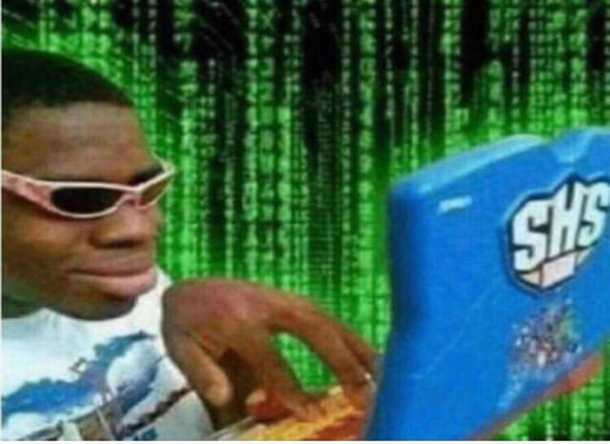
THE WORKING BROS
HOME
ABOUT US
CONTACT
ABOUT OUR PROJECT
Our project is to serve the community appetite by fast food.
It is our purpose for them to place order at our website for their food and consume it because nothing beats a quick meal to eat!

Slide 4

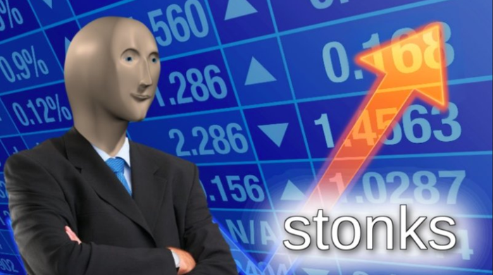
THE WORKING BROS
HOME
ABOUT US
CONTACT
01
To become the go-to online destination for fast food lovers by delivering the most mouthwatering menus, real-time deals, and honest reviews — all in one place. We aim to celebrate the joy of fast food by connecting people with their favorite bites, wherever they are.
VISION
02
Our vision is to build a vibrant fast food hub by partnering with a wide range of restaurants and brands, creating a one-stop platform where customers can explore, order, and enjoy their favorite meals with ease. We aim to grow a community that connects food lovers with great deals, new flavors, and trusted local and global names in fast food.

Slide 5

THE WORKING BROS
HOME
ABOUT US
CONTACT
01
Provide customers with fast, delicious and cost-effective meals, making every meal full of satisfaction.
02
Provide customers with fast, delicious and cost-effective meals, making every meal full of satisfaction.
MISSION
03
Use technology to simplify dining choices: customize your own meal online to save time and worry.
04
Transparent kitchen, full traceability - check the source of ingredients online in real time and eat with confidence.

Slide 6

THE WORKING BROS
HOME
ABOUT US
CONTACT
FAST FOOD IS MORE THAN QUICK BITES — IT’S COMFORT, CONNECTION, AND EVERYDAY JOY. WE’RE INSPIRED BY THE WAY FOOD BRINGS PEOPLE TOGETHER, AND IT IS OUR DUTY TO MAKE THAT EASIER BY PARTNERING WITH MORE BRANDS AND LOCAL SPOTS TO BRING THE BEST FLAVORS TO YOUR FINGERTIPS.
READ ME
It was that one evening, we were hungry and tired after a long day, we found ourselves endlessly scrolling through food delivery apps, struggling to find that perfect meal. Too many ads and discount popping out, too many choices, and somehow. There’s still nothing satisfying .
That’s when it hit us. Why isn’t there one place where fast food lovers can easily explore menus, discover new deals, and connect with both big-name chains and hidden local gems through the simplicity design.

Slide 7





THE WORKING BROS
HOME
ABOUT US
CONTACT
GET IN TOUCH WITH US
+6010-888-3828
hello@reallygreatsite.com
www.reallygreatsite.com

Slide 8

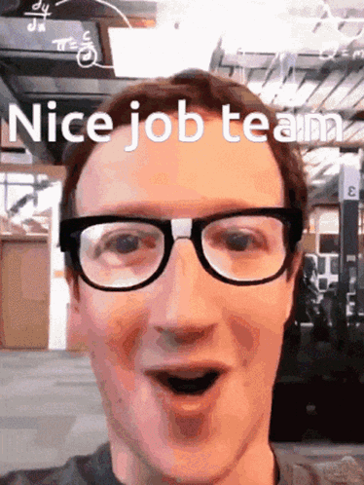
THE WORKING BROS
THANK YOU
4 AUGUST 2025

